Slide 1

Parcel process week 7
G. Ottens
R. Hagenaar
L. vd. Stolpe
E. Açıkgöz
I. Bensaga
I. Böyükşimşek

Slide 2
Content
Preface
Accomplishments
Planning for this week
Questions

Slide 3
preface
Postnl problem
Our project owner: Tim Ottens
Data we received

Slide 4
Accomplishments
Different kinds of graphs
Number of packages per customer per week
Box plot of the number of packages per customer
Datacamp
literature study

Slide 5
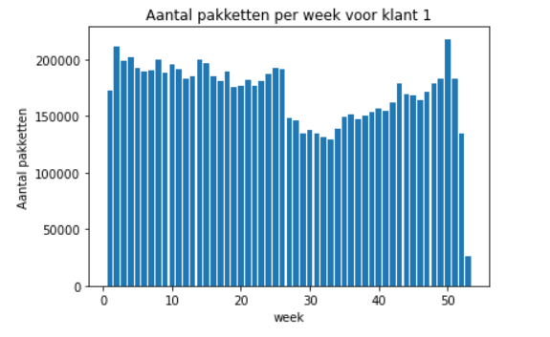
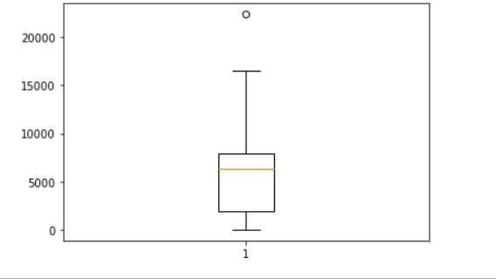

Left:packages per week, Right: boxplot

Slide 6
Planning for this week
Finish until the 10th chapter of Datacamp
Research on the different machine learning models
Make some new graphs with machine learning models

Slide 7

Questions

